Slide 1
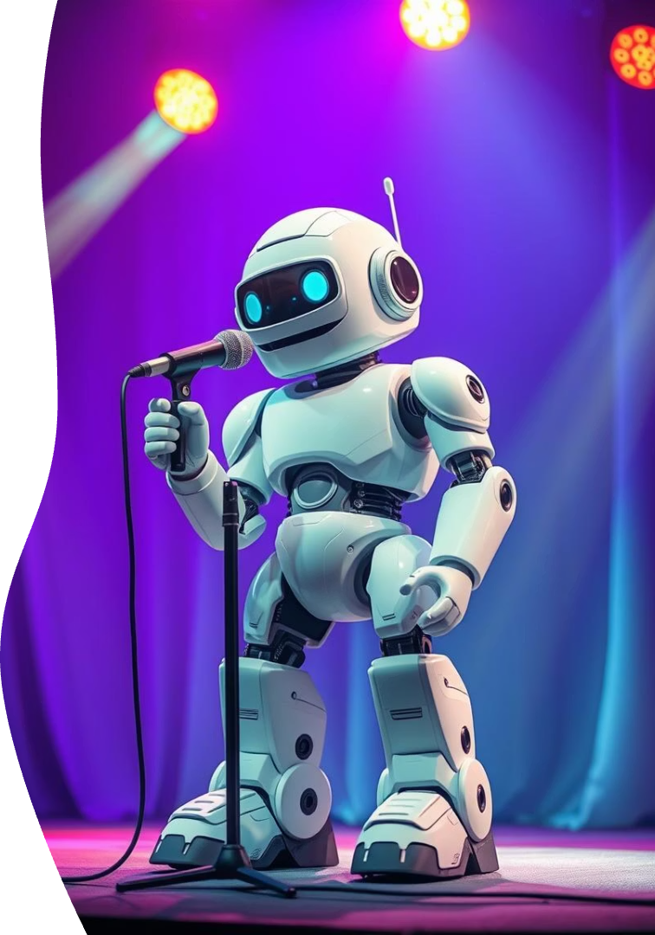
Introducing ComediBot: Python-Powered Stand-Up
Revolutionizing comedy by generating original stand-up routines. Bridging tech and humor seamlessly.

Slide 2
The Core Concept: AI Stand-Up Comedian
Input
Process
Output
Topic, style, and target audience drive the humor focus.
Python scripts use NLP to craft jokes, stories, and punchlines.
Complete stand-up routines lasting 3-5 minutes.
Slide 2

Slide 3
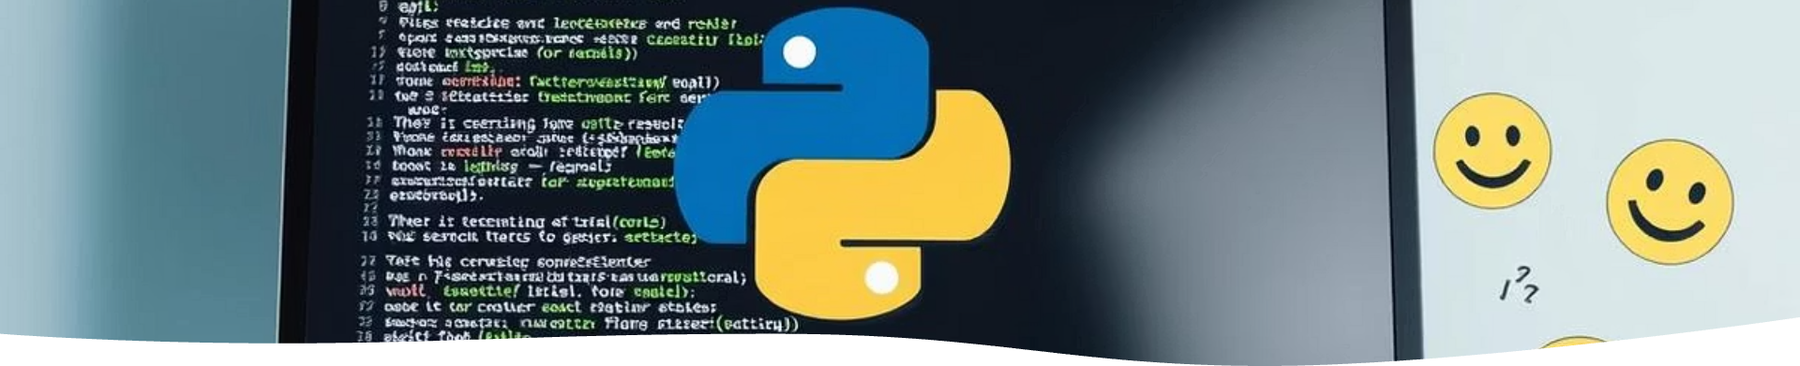
Tech Stack: Python & Comedy Algorithms
Natural Language Processing
Machine Learning
Comedy Theory
Advanced models like GPT-3 generate creative comedic text.
Algorithms apply joke structure and comedic timing principles.
Tools like spaCy and NLTK analyze and understand language.
Slide 3

Slide 4

Development Process: Training the Bot
Data Collection
Large datasets of stand-up scripts and jokes fuel learning.
Model Training
Fine-tuning helps the AI grasp humor styles and patterns.
Evaluation
Human feedback refines joke quality and delivery impact.
Slide 4

Slide 5

ComediBot in Action: Sample Routines
Dating Barista
Change Therapy
Cats vs. Dogs
Witty observational humor with relatable coffee shop tales.
Self-deprecating jokes about embracing change and growing.
Lighthearted comedic comparison of beloved pets.
Slide 5

Slide 6
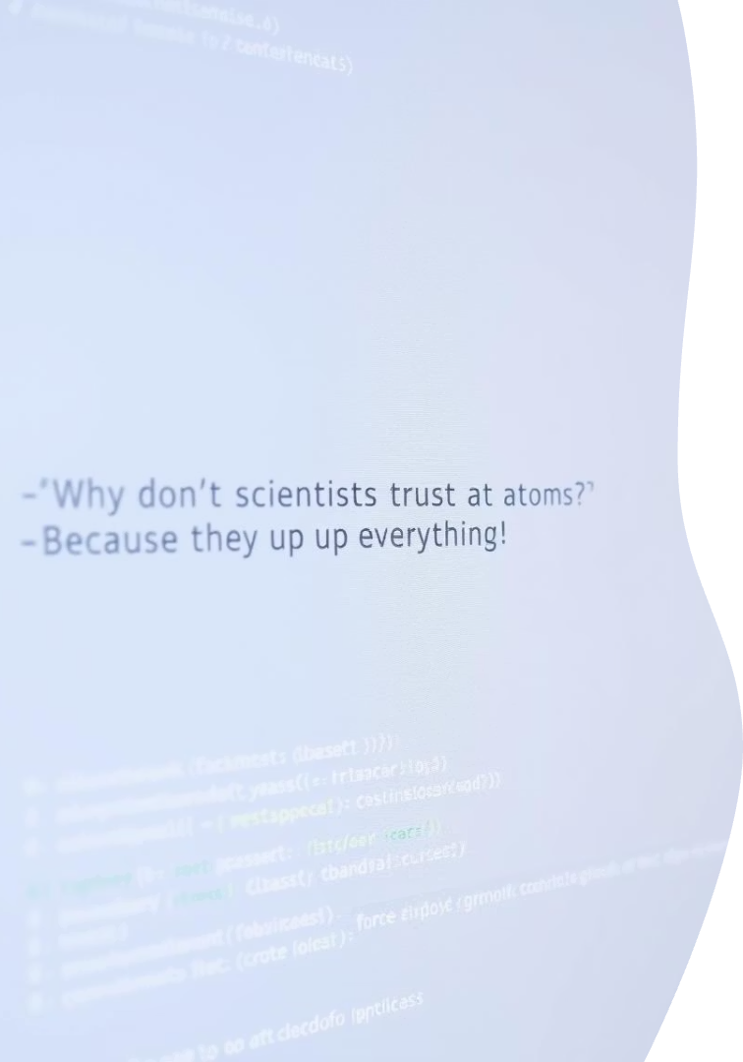
Showcasing Python Code: Joke Generation
1
Pun Creation
Using Python’s `random` and `re` libraries creatively.
2
Sentiment Analysis
Helps fine-tune jokes for tone and audience mood.
Slide 6

Slide 7



Future Potential: Beyond Text-Based Comedy
Real-Time Adaptation
2
Audience reaction tracking via sentiment analysis.
Voice Integration
1
Enhancing comedy with vocal delivery and timing.
Personalized Comedy
Recommendations tailored to user preferences.
3
Slide 7

Slide 8

The Future is Funny: Join the ComediBot Revolution
Transforming Entertainment
API Access
Integrate ComediBot’s humor into your applications.
AI-generated comedy reshapes how laughter is created.
Investment Opportunities
Partner with us to pioneer AI comedy innovation.

